Slide 1
Phonics and Reading Meeting for Parents
Wednesday 9th October 2019

Slide 2
What is phonics?
Identifying sounds in spoken words.
recognising the common spellings of each sounds.
    blending sounds into words for reading.
segmenting words into sounds for spelling.

Slide 3
Letters and Sounds
In school, we follow the Letters and Sounds programme. Letters and Sounds is a phonics resource published by the Department for Education which consists of six phases.

Slide 4
Terminology
Phoneme – the smallest unit of sound in a word
Grapheme – a letter or group of letters that represents a sound
Segmenting – breaking the word down for spelling
Blending – building words from sounds to read
Digraph – a grapheme where two letters make one sound
Trigraph – a grapheme where three letters make one sound
Split digraph – a digraph where the two letters are not together e.g. like
Tricky words – words that cannot be sounded e.g. was

Slide 5
Phase 1
This should be covered when the children are at Nursery
There are 7 aspects with 3 strands.
A1 – Environmental
A2 – Instrumental sounds
A3 – Body Percussion
A4 – Rhythm and rhyme
A5 – Alliteration
A6 – Voice sounds
A7 – Oral blending and segmenting.

Slide 6
Phase 2
This is taught in Foundation Stage
Set 1: s, a, t, p
Set 2: i, n, m, d
Set 3: g, o, c, k
Set 4: ck, e, u, r
Set 5: h, b, f, ff, l, ll, ss
Tricky words – the to, go, no I
Read and write VC e.g. ‘at’ and CVC words e.g. ‘cat’

Slide 7
Phase 3
This is taught in Foundation Stage
Set 6: j, v, w, x
Set 7: y, z, zz, qu
Consonant digraphs: ch, sh, th, ng
Vowel digraphs: ai, ee, igh, oa, oo, ar, or, ur, ow, oi, ear, air, ure, er
Tricky words – he, she, we, me, be, was, my, you, her, they, all, are
Read and spell words that include the digraphs above.
Read and spell two syllable words e.g. treetop

Slide 8
Phase 4 this is taught in Foundation Stage and Year 1
This phase consolidates all the children have learnt in the previous phases.
There are no new sounds.
Tricky words – said, so, have, like, some, come, were, there, little, one, do, when, out, what
Blending and segmenting longer words e.g. went, frog, stand, paint, brown, spoil, treetop, sandwich

Slide 9
Phase 5
Taught in year 1
Children will be taught new grapheme and alternative ways of saying/reading the graphemes.
Vowel digraphs: ay, ou, ie, ea, oy, ir, ue, aw, ew, oe, au.
Digraphs: wh and ph
Split digraphs: a-e, e-e, i-e, o-e, u-e
Tricky words: oh, their, people, Mr, Mrs, looked, called, asked, water, where, who, again, though, through, work, mouse, many, laughed, because, different, any, eyes, friends, once, please

Slide 10
Phase 6
Taught throughout year 2
The focus is on learning spelling rules for suffixes.
-s -es -ing
-ed -er -est
-y -en -ful
-ly -ment -ness

Slide 11
Blending
Building words from phonemes to read
c a t
cat

Slide 12
Blending
Building words from phonemes to read
qu ee n
queen

Slide 13
Segmenting
Breaking down words for spelling
cat
c a t

Slide 14
Segmenting
Breaking down words for spelling
Queen
qu ee n

Slide 15
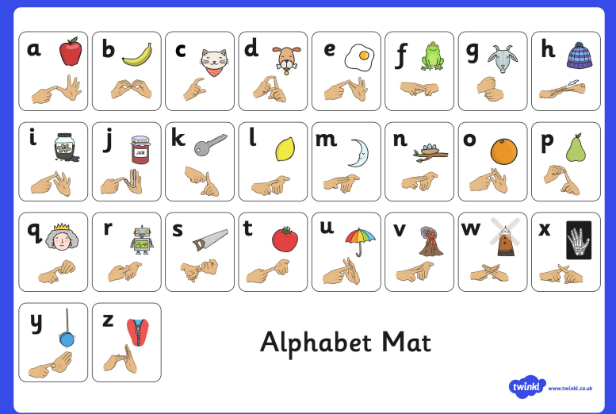
Fingerspelling

Slide 16
What does a phonics lesson look like?
daily discrete session
approximately 15/20 minutes
multi-sensory
active
REVISIT/
REVIEW
TEACH
PRACTICE
APPLY

Slide 17
Supporting with phonics at home
Read with the children regularly at home. Little and often.
Encourage children to sound out unfamiliar words when reading their books.
Remember not all words can be broken down into sounds. If it is a tricky word then tell your child what is says.
Give children the opportunity to write at home. It may just look like strings of letters to begin with but this will develop as the children learn more sounds.

Slide 18
Reading Memories
Do you have a good childhood memory about books and reading?
Do you have an unpleasant memory?
It is the conditions and feelings associated with your good memory that should be recreated for reading with your child.

Slide 19
Reading is challenging
Reading is a code that children need to understand. Codes are made to be broken! Can you read this?
  Onc up a time th we thr litt p s wh liv wi thr happy moth in
  a pr hou i th oods.

Slide 20
Reading in school
Phonics
Shared reading – stories at the end of the day. Books related to topic.
Guided reading
Independent reading – in the book corner
Focused reading activities
Reading lesson
School readers Home readers
The hearing of reading is NOT the teaching of reading

Slide 21
Reading at home
Make it fun and share as many books as possible.
Revisit books. There is nothing wrong with reading a familiar book or a familiar text.
Praise them in their efforts and make them feel as though they are achieving.
Try to read your child’s school book at least 3 times a week. 1page is better than no pages. Little and often is better than nothing at all.

Slide 22
Strategies to use with your child at home
Talk about the title and front cover.
What do they think the book is about?
Allow them to have a go at reading.
Use phonics first. What sound does the word begin with? Can you say the sounds in the word? Blend them together.
Does it sound right?
Look at the picture. Does it help?
Talk about repeated words. If you know them, you do not need to sound them out again.

Slide 23
Strategies contd…
Tricky words can not be sounded out. They just need to know them e.g. words such as ‘the’ and ‘was’.
Talk about the book at the end. Who is your favourite character? How would you feel? What do you think will happen next? What would you do? What can you tell me about the book?

Slide 24
Hearing your child read
Choose a quiet time and give your child your full attention.
Give support if required using the strategies explained earlier.
Explain the meaning of new words.
Do not force your child to read if they are not in the mood. We want to develop a love of reading.

Slide 25
Reading to your child
Introduce your children to different types of books; classic fiction, chapter books, short stories, joke books, poetry, non-fiction.
Read them the book that was your favourite when you were a child.
Read slowly, with expression. Try to use different and funny voices for characters.
Follow the words and read the story using the pictures.
Talk about what is happening and what might happen next. Leave the story on a cliffhanger!

Slide 26
Websites
https://www.bbc.co.uk/cbeebies/games/alphablocks-games
https://www.phonicsplay.co.uk/
https://www.youtube.com/watch?v=TvMyssfAUx0&safe=active (tricky word song)
https://www.youtube.com/watch?v=mMog84sQp3o (Mr tumble fingerspelling)

Slide 27
And finally…
Please do not worry about the colour book other children are reading on in the class. We want to focus on your child.
It is not a test! Have fun!
We are here to offer help and guidance at any time.

