Slide 1
Tara Lewis
School Health Education Specialist
Public Health
Relationship and Sex Education and Health Education (RSE) in Primary Schools

Slide 2
Aims
Why have there been changes to RSE and Health education and what are the statutory?
How does RSE contribute to safeguarding?
What are the concerns regarding teaching RSE?
What skills are needed to deliver RSE appropriately?
What is the Christopher Winter Project RSE resource?

Slide 3
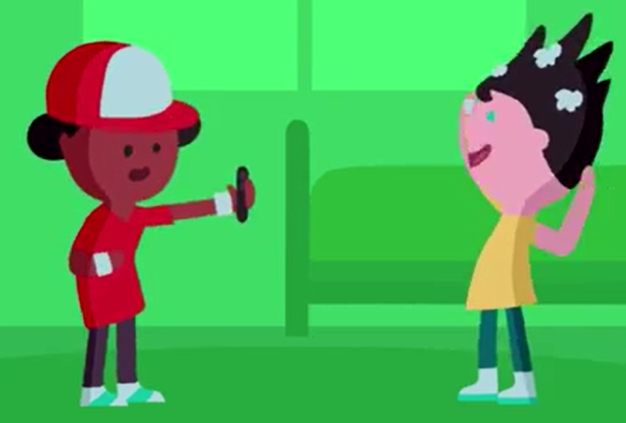
What are the threats?
Cyberbullying
Bullying
Sexting
Child sexual exploitation
Addictive behaviours
Early exposure to pornography
Unhealthy teenage relationships
Online grooming
Obesity
Physically inactivity
Emotional health and mental wellbeing problems
Low self esteem
Exposure to extreme violence
Radicalisation
Alternative facts
Dangerous fads
Peer on peer exploitation
Gangs and knife crime
Intolerance

Slide 4
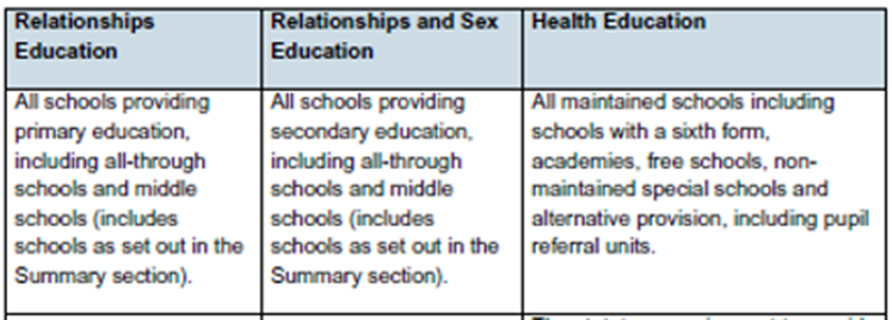

Statutory changes (For Sept 2020)

Slide 5
Mental wellbeing
Internet safety and harms
Changing adolescent body
Basic first aid
Health and prevention
Drugs, alcohol and tobacco
Healthy eating
Physical health and fitness
Health Education

Slide 6
Respectful relationships
Online relationships
Caring friendships
Families and people who care for me
Being safe
Relationships Education

Slide 7
Relationships education is age-appropriate, building knowledge and life skills over time in a way that prepares pupils for issues they will soon face.
The focus is on:
different types of relationships, including friendships, family relationships and dealing with strangers
how to recognise, understand and build healthy relationships, including self-respect and respect for others, commitment, tolerance, boundaries and consent, and how to manage conflict, and also how to recognise unhealthy relationships.
how relationships may affect health and wellbeing, including mental health;
healthy relationships and safety online

Slide 8
Our Children
Luton SHEU survey

Slide 9
23% of pupils responded that they have seen images or videos online that were for adults only.
24% pupils responded that they have seen images or videos online that upset them.
25% of pupils responded that they use internet chat rooms or social networking sites 'often' or 'very often.
15% of pupils responded that they have received a chat message that scared them or made them
15% of boys and 20% of girls responding that they worry 'quite a lot' or 'a lot' about body changes as they grow up.
20% responded that no-one has talked with them about body changes as they grow up.
39% Seek help from books/magazines/internet
24% of pupils had a med-low self-esteem score.

Slide 10
RSE is important
Children are at risk of sexual exploitation, sexual abuse and grooming
Children do not know how to deal with cyberbullying, sexting and sexual bullying/ harassment
The digital world is a mine field for young minds
Children have access to pornography
Changing relationship expectations and a growing number of abusive teenage relationships
RE is inclusive
Child Protection and safeguarding
A whole school approach to RSE creates a strong message of expectation inside and outside of school
Children AND parents have asked for RSE to be delivered in schools
Children are exposed to unrealistic images of how they should look

Slide 11
RSE@Luton
Luton and our partner agencies are committed to ensuring our children and young people are given the knowledge and tools to develop into healthy, informed and emotionally well citizens within modern Britain. Supporting children to develop positive relationship with themselves, their peers and the wider community.
Our RSE curriculum is in line with Luton Council values, in particular:
• Embrace equality and diversity, cohesion and inclusion
• Show respect for others

Slide 12
Concerns
What if the children ask personal questions
How do you know what is appropriate to teach?
Does RSE sexualise children?
I am worried about the types of questions the children will ask
Is it okay to talk about same sex relationships?
I don’t know what language to use?
If we talk about gay families will it make children gay?
I don’t believe in homosexuality. It is against my faith

Slide 13
Teaching RSE – Good practice
Always develop ground rules for RSE with the whole class and refer to them regularly.
Confidentiality.
Agree with class not to ask personal questions/not volunteer personal information.
Use distancing techniques.
Information should be medically and factually correct.
Taught without bias or personal opinion.
Fine to say you don’t know.
Promote equality.
Talk about sexuality without promoting any one type of relationship.
Understand and communicate the schools stance on RSE and related subjects with parents, pupils and each other.
Parents are informed when RSE will be taught so that they can support their children at home .

Slide 14
Christopher Winter Project
Focus on safeguarding and keeping children safe
A RSE programme of study (reception through to Year 6)
Spiralling programme building on skills and knowledge.
Year 3
Naming body parts
Touch and personal space
Year 6
Understanding inappropriate/ appropriate touch
Online safety
Communications in relationships

Slide 15
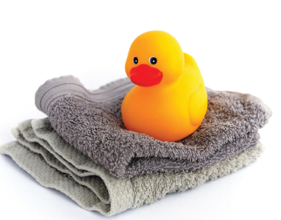
Schemes of Work: Early Years
Families
Keeping ourselves clean
Our Day

Slide 16
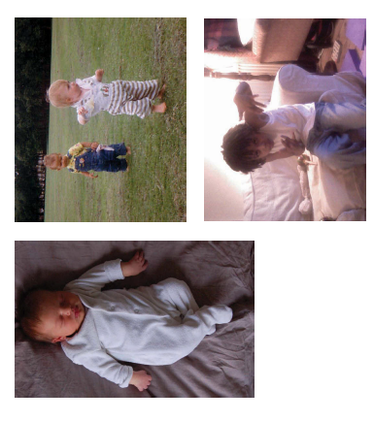
Schemes of Work: Year 1
Keeping clean
Growing and changing
Families and care

Slide 17
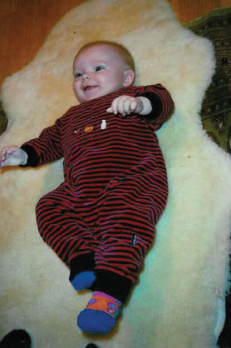
Schemes of Work: Year 2
Differences; male and female
Naming body parts
Differences; boys and girls

Slide 18
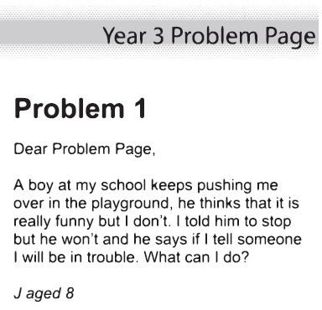
Schemes of Work: Year 3
Personal space
Differences between males and female
Family Differences

Slide 19
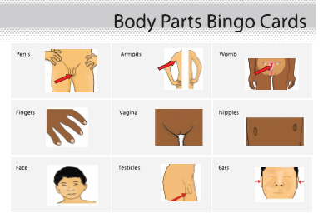
Schemes of Work: Year 4
Growing and changing
What is puberty
Puberty changes and reproduction

Slide 20
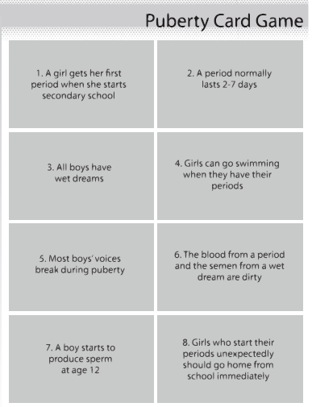
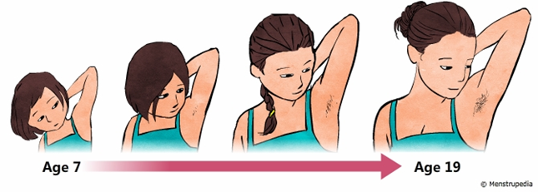
Schemes of Work: Year 5
Talking about puberty
Male and female changes
Puberty and hygiene

Slide 21
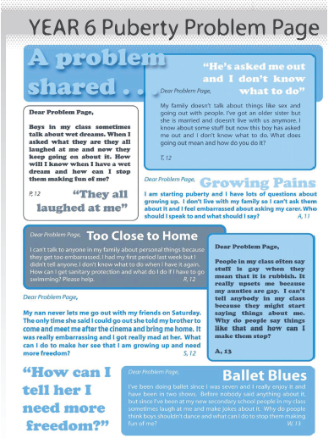
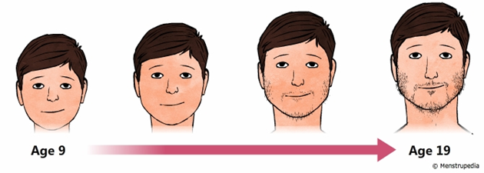
Schemes of Work: Year 6
Conception and pregnancy
Puberty and reproduction
Understanding relationships
Communication in relationships

Slide 22


