Slide 1
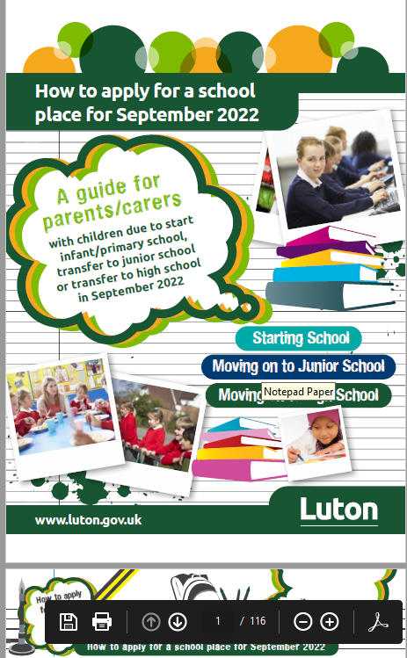

How to apply for a high school place 2022
Access to Education Team
accesstoeducation@luton.gov.uk
Lauren Middleton
Access to Education Officer
07725607058
Tracey Back
Access to Education Family Worker
07818014511
Tracy Gentle
Access to Education Manager
07920072030

Slide 2
Moving on to high school
We hope that these slides will answer any questions you may have and help you when applying for your child’s high school place.
Moving on to high school is an important time for your child, therefore please take the time to read through the information provided.
Look out for information from your child’s school on additional advice services from the Access to Education Team.

Slide 3
National closing date
31ST OCTOBER 2021
It is vital that all parents submit an online application before the closing date. Late applications will not be processed until after the offer date.

Slide 4
Things to remember
Look up your catchment area school at www.luton.gov.uk/admissions or by contacting the Admissions helpline. Remember, if you want a place at your catchment area school, you must still apply and name that school as one of your preferences.
Prepare the additional documents that you will need to upload such as:
    Proof of address is needed for some schools: Challney High school for Boys, Challney High school for Girls, Chiltern Academy, Denbigh High School and Putteridge High School.
    Catholic school applications will need your child’s original Baptismal Certificate and a supplementary form.
Look at the ‘How to apply for a school place 2022’ guide available at Luton School Admissions home page The guide gives information on individual schools and academies in Luton allowing you to judge your chances of securing a place at your preferred schools.
Have your email address and password ready as you will need these during the registration process.

Slide 5
Where to find the application?
You can apply online for a school place at www.luton.gov.uk/admissions

Slide 6
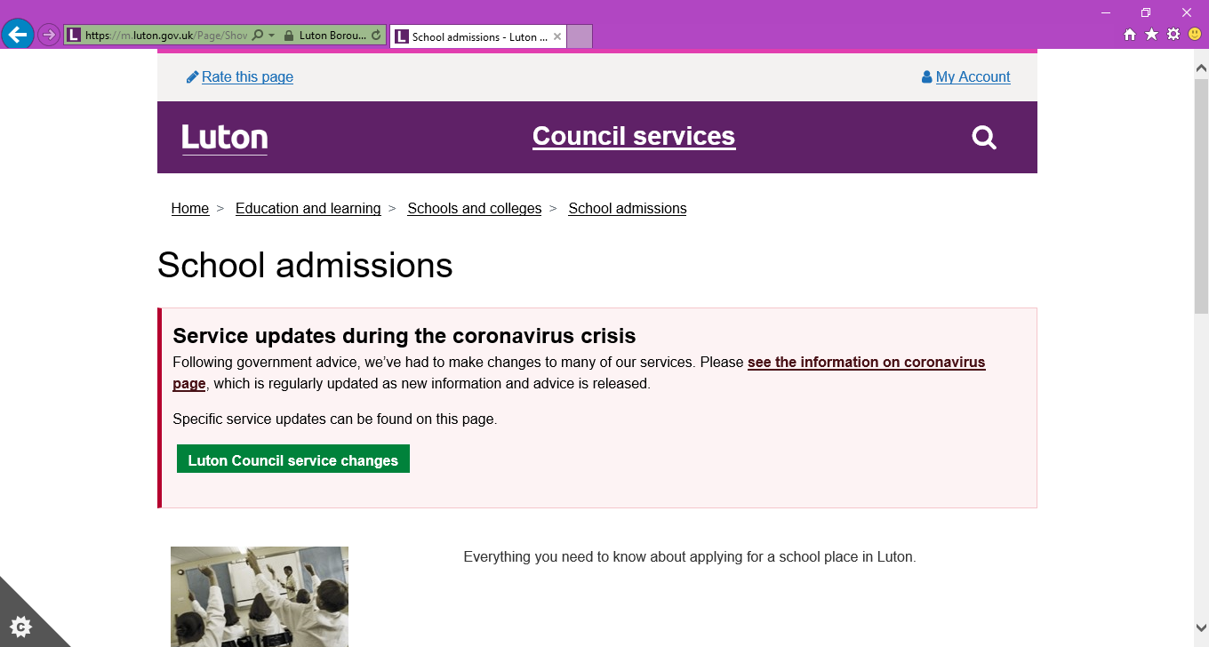
How to apply online stage 1
Go to Luton School Admissions home page
It should look like the image from the web page below

Slide 7
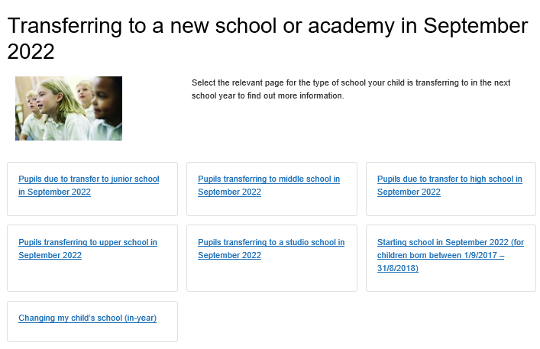
How to apply online stage 2
Scroll down to view all options
It should look like the image below
Click on Transferring to a new school or academy

Slide 8

How to apply online stage 3
Click on Pupils due to transfer to High School in September 2022 as shown in the image below

Slide 9
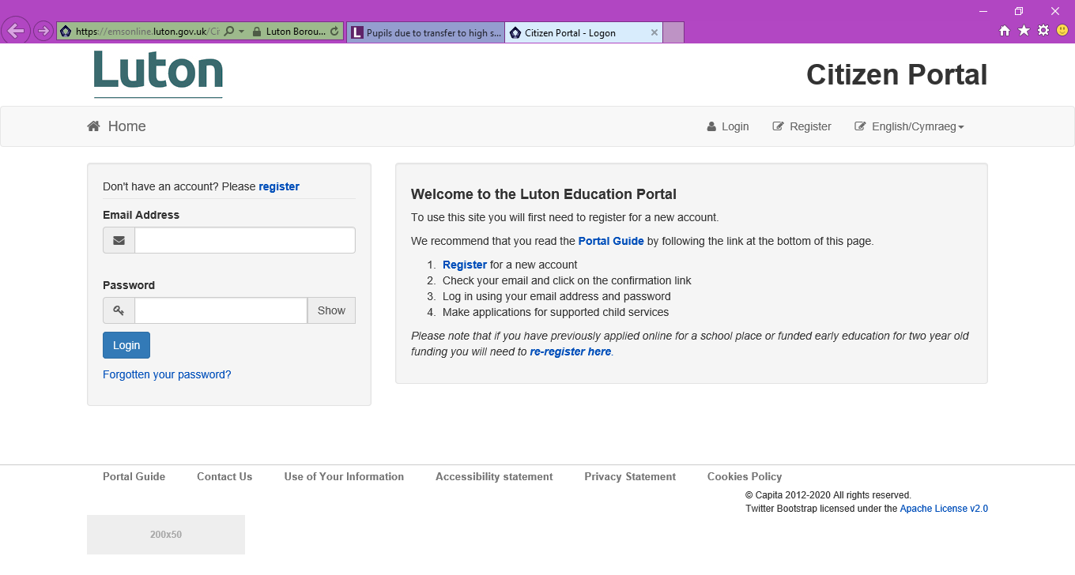
How to apply online stage 5
Once you have clicked on “Go to education portal” the screen will look like the image below

Slide 10
Tips and hints on how to use the portal
You may need to register for a new account, even if you have used the portal before.
You will be sent an email and click on the confirmation link.
You are ready to log in using your email address and password.
Follow the steps.
You can go back into the portal as many times as you like prior to the closing date if you wish to make changes. Preferences can be changed at any time until the closing date.
Remember to put information of siblings who will be attending the preferred school at the time your child transfers.
At the end remember to click submit.

Slide 11
Preferences
You can apply for three schools – these are called preferences and all three will be given equal consideration. Parents/carers must identify their first, second and third preference schools on their application. It is important to name three different schools.
It is vital that you understand how places will be allocated if there are more applicants for your preferred schools than places available (see pages 86–111 for transfer to high school of the How to apply for a school place 2022 guide).
Ensure that you consider realistic ‘back-up’ preferences. Think about scenarios and the logistics should the preferred school(s) not be allocated.
You can apply to any school or academy. Remember to consider how likely you are going to be and refer to the booklet to gauge what your chances are. Always consider putting the catchment area school as a back up preference.
Applications for Luton schools and out of borough schools should be applied for via Luton Borough Council.
Apply directly via the school if applying for a private school.

Slide 12
What to consider when thinking about preferences?
How will your child get there? Remember any transport costs are usually the responsibility of the parents (see pages 16 - 17 ‘How to apply for a school place 2022’ guide for information on eligibility for assistance with transport).
What are the views of your child? Does My child like it here? Will they be happy? Ask your child, they may have strong ideas about the school they would prefer to attend.
Range of facilities. All schools and academies have similar facilities but look into whether the school has any unique specialist areas.
Keep an open mind.
Consider realistic ‘back-up’ options. Visit your catchment school.

Slide 13
Frequently asked questions
If I apply early I will get my first choice school? No, applications are not processed on a first come first served basis. Places are allocated using the schools admissions criteria which you can find in the How to apply for a school place 2022 guide.
If I apply for the same school three times will I stand a better chance? No, you should apply for three different schools.
We might move house, shall I wait until we move? You must apply at the address you are living at prior to the closing date.
We have other children attending our preferred school, will this guarantee a place for my child? Please remember to add the sibling to the application however this does not guarantee you a place automatically.
My child has a cousin at the school, do they count as a sibling? No, cousins do not count as siblings.

Slide 14
Applying to Catholic schools
Parents wishing to apply for a place at Cardinal Newman Catholic School, please be aware their September 2022 Admissions Policy is slightly different to their one last year.
Parents must in addition to their application complete the school’s supplementary form and provide the original Baptismal certificate, parents can also provide a First Holy Communion certificate (must be the original) if you do not have a Baptism Certificate.
The supplementary form and Baptismal certificate can be returned to the child’s current catholic school or Cardinal Newman directly if your child is not attending a feeder school. For practising Catholics – Parents will need to ask their priest directly for a Certificate of Catholic practice.
Supplementary forms and baptismal certificates MUST be submitted by the closing date. The supplementary form has been updated – the new supplementary form can be found here: Supplementary-Form-2022.pdf (cardinalnewmanschool.net) or collected from Cardinal Newman directly.
For out of borough Catholic Schools please refer to the individual schools for their application process.
Notes:
’Certificate of Catholic Practice’ means a certificate issued by the family’s parish priest (or the priest in charge of the church where the family attends Mass) in the form laid down by the Bishops’ Conference of England and Wales. It will be issued if the priest is satisfied that at least one Catholic parent or carer (along with the child, if he or she is over seven years old) have (except when it was impossible to do so) attended Mass on Sundays and holy days of obligation for at least five years (or, in the case of a child, since the age of seven, if shorter). It will also be issued when the practice has been continuous since being received into the Church if that occurred less than five years ago. It is expected that most Certificates will be issued on the basis of attendance. A Certificate may also be issued by the priest when attendance is interrupted by exceptional circumstances which excuse from the obligation to attend on that occasion or occasions.

Slide 15
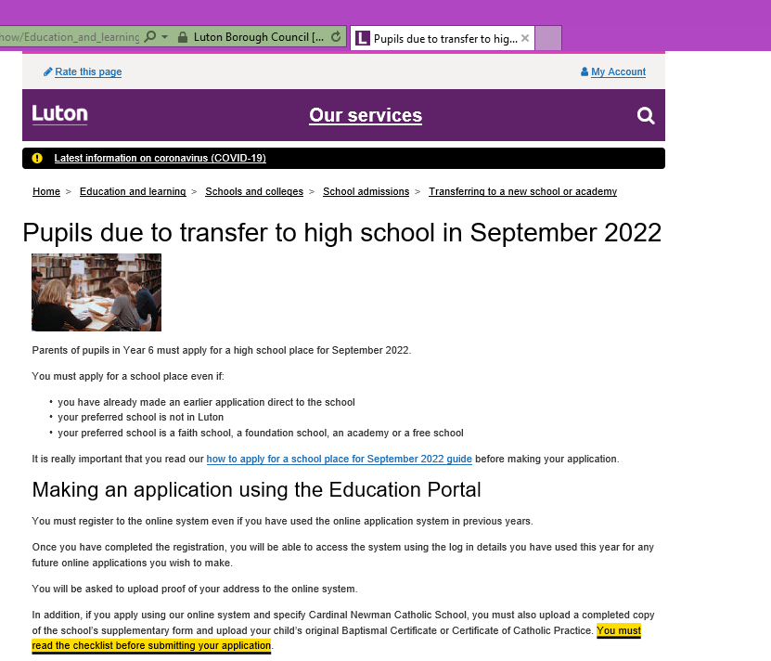
How to apply online stage 4
The image below shows where you can find the How to apply for a school place guide. If you scroll down you will find the green link Go to education portal.

Slide 16
Applying to Private or Grammar schools
Private schools should be applied directly via the schools and not on the Local Authority application form. Parents/ carers should still apply for Luton schools before the closing date in case of a change of circumstances.
Apply for the Grammar school via LA application form
(Make sure to contact the relevant local authority about your child sitting the entry tests).

Slide 17
When do we hear which school has been allocated?
National Offer date is 1st March 2022
Decision letters will be sent to parents on 1st March 2022.
Later on, the allocated school will provide you with further information with details of induction days so your child gets to know his or her new school.

Slide 18
Appeal Process
If it is not possible to allocate your child a place at one of your preferred schools you can ask for your case to be considered by an independent appeal panel.
Parents/ carers can apply for an appeal for any school preference that they have applied for and have been unsuccessful.
An appeal application needs to be submitted within 20 school days from receipt of the offer letter to be considered in the first round of appeals.
There are no guarantees that an appeal will be upheld. It is important that you do not rely on the appeal process to gain a place at your preferred school.
You can only appeal once per academic year unless there are significant and material changes to circumstances.

Slide 19
Additional support
The Access to Education Team will be sending further information through your child’s school advising of opportunities to join us via virtual question an answer sessions prior to the closing date. Please do join us.
If you still have questions or would like to receive assistance with completing your child’s application please do not hesitate to contact the Access to Education Team by contacting accesstoeducation@luton.gov.uk to make an appointment for support.
We wish your child every success with their transition to high school.

