Slide 1


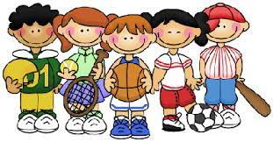
School Clubs and Activities
 | Monday | Tuesday | Wednesday | Thursday | Friday
Before school | Y5 & Y6 Cookery (Mrs Ridley) | Y1, Y2 & Y3 Multisport (Mr Murgatroyd) Current Y4, Y5 & Y6 Intermediate Violin (Mrs Santana) | Y4, Y5 & Y6 Cricket/Rounders (Mr Murgatroyd) | Y4, Y5 & Y6 Tennis (Mr Murgatroyd) | Current Y4, Y5 & Y6 Brass Lessons (Mrs Gardner & PHS) Y3, Y4, Y5 & Y6 Glow in the dark Dodgeball (SportsCool)
Lunch time
After school | Y4, Y5 & Y6 Football (Mr Murgatroyd) Y1 & Y2 BSL (Mrs Oliver/Mrs Jakso) | Y1,Y2,Y3,Y4,Y5 & Y6 Roblox Game Designers (Jam Coding) | Y1, Y2 & Y3 Street Dance (Abigail, KL Dance) | Y1, Y2 & Y3 Football (Mr Murgatroyd) | Y4, Y2 & Y3 Cheerleading (Abigail, KL Dance)

